Slide 1

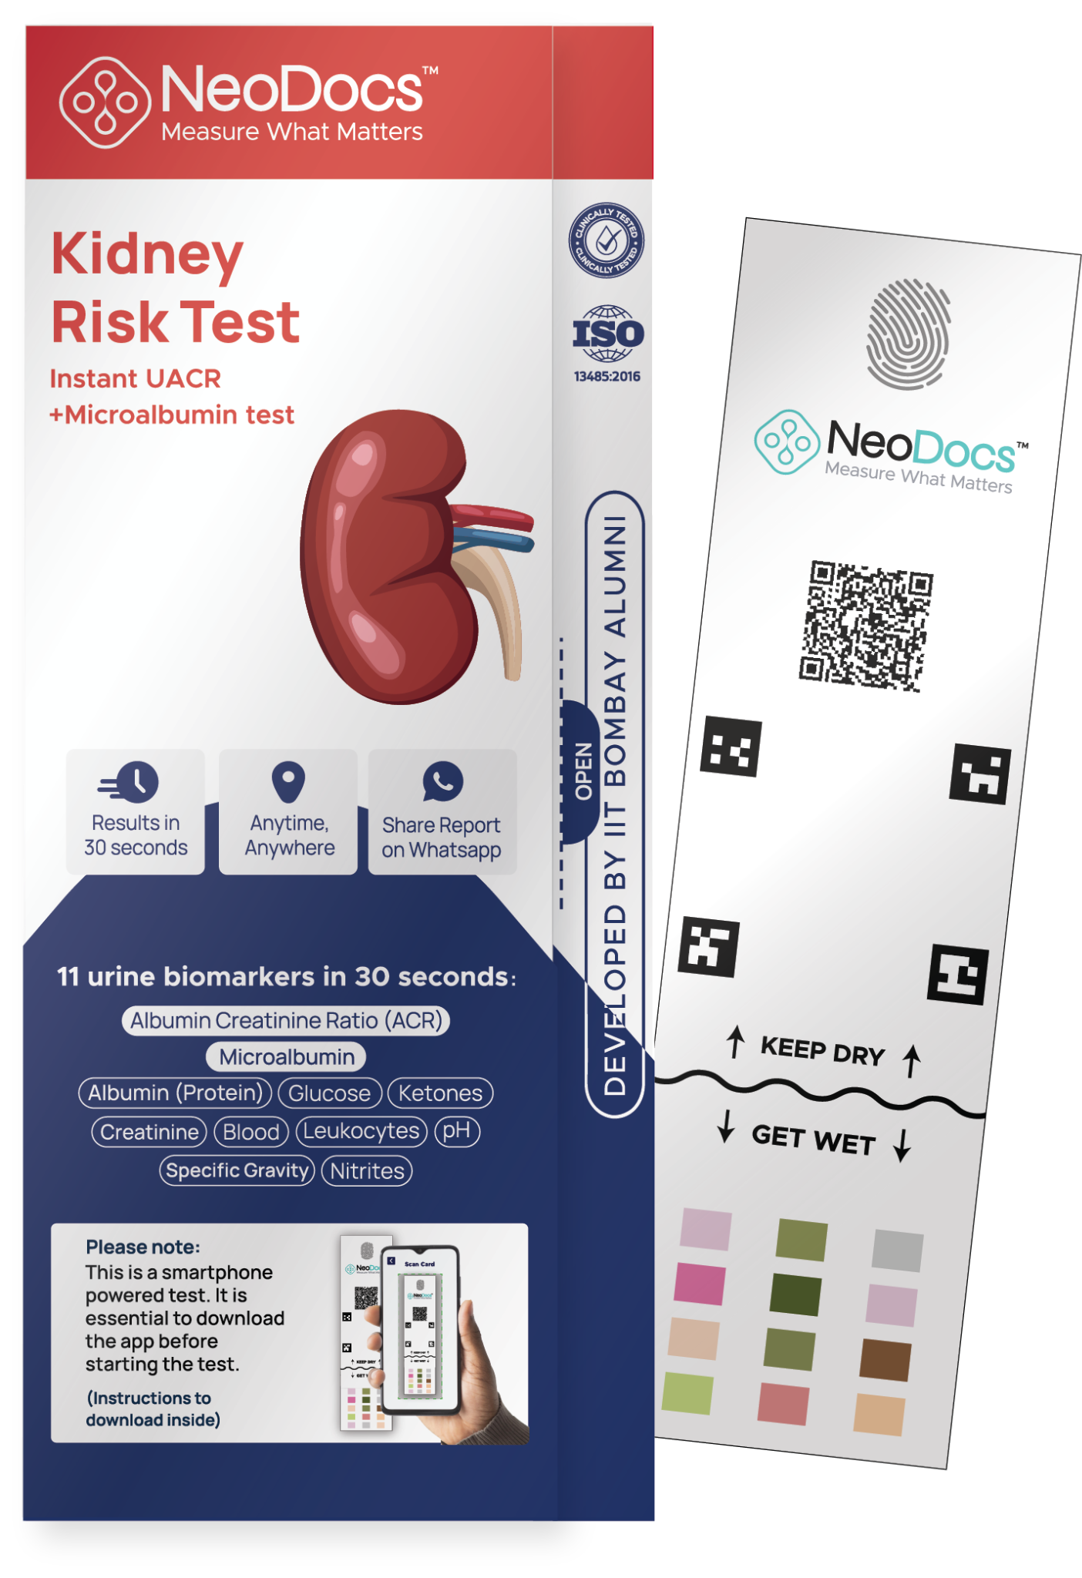


MONTHLY UPDATE - UACR CAMPS
Instant UACR on any phone
In-clinic + At-home

Slide 2
Overview
High-level summary of testing performance
Total Tests
Total Camps
Total Doctors
4,670
1,788
389
A2+A3 Abnormality
States Covered
40%
22
Neodocs YCS21 • Confidential • Pharma Insights Report
1

Slide 3
State Wise Testing (Till November 2025)
State | Total Tests | Total Camps | A1 | A2 | A3 | Abnormality %
West Bengal | 938 | 194 | 608 | 217 | 113 | 35%
Maharashtra | 867 | 317 | 510 | 204 | 153 | 42%
Rajasthan | 544 | 340 | 351 | 115 | 78 | 35%
Delhi | 485 | 140 | 269 | 160 | 56 | 45%
Assam | 408 | 229 | 218 | 93 | 97 | 46%
Tamil Nadu | 364 | 149 | 233 | 94 | 37 | 36%
Telangana | 307 | 123 | 193 | 79 | 35 | 38%
Andhra Pradesh | 260 | 105 | 151 | 62 | 47 | 43%
Gujarat | 152 | 49 | 104 | 36 | 12 | 31%
Odisha | 89 | 11 | 55 | 28 | 6 | 38%
Chhattisgarh | 75 | 54 | 38 | 20 | 17 | 49%
Puducherry | 35 | 27 | 20 | 7 | 8 | 42%
Karnataka | 27 | 20 | 19 | 2 | 6 | 29%
Neodocs YCS21 • Confidential • Pharma Insights Report
2

Slide 4
City Wise Testing (Till November 2025)
Orgcity | Total Tests | Total Camps | A1 | A2 | A3 | Abnormality %
Kolkata | 719 | 149 | 457 | 177 | 85 | 37%
Mumbai | 714 | 264 | 411 | 169 | 134 | 43%
Delhi | 485 | 140 | 269 | 160 | 56 | 45%
Hyderabad | 298 | 114 | 190 | 76 | 32 | 37%
Chennai | 269 | 96 | 167 | 73 | 29 | 39%
Guwahati | 211 | 120 | 107 | 50 | 54 | 49%
Jodhpur | 170 | 108 | 102 | 46 | 22 | 41%
Nagaon | 162 | 94 | 91 | 35 | 36 | 43%
Kota | 159 | 90 | 97 | 32 | 30 | 38%
Ajmer | 107 | 71 | 80 | 25 | 2 | 25%
Hooghly | 89 | 7 | 63 | 18 | 8 | 30%
Visakhapatnam | 83 | 36 | 45 | 21 | 17 | 45%
Bilaspur Ch | 75 | 54 | 38 | 20 | 17 | 49%
Nagpur | 73 | 9 | 56 | 11 | 6 | 23%
Howrah | 62 | 15 | 38 | 10 | 14 | 38%
Neodocs YCS21 • Confidential • Pharma Insights Report
3

Slide 5
Speciality Wise Testing (Till November 2025)
Specialization | Total Tests | Total Camps | A1 | A2 | A3 | Abnormality %
Diabetologist | 1364 | 505 | 882 | 345 | 137 | 35%
Others | 772 | 272 | 458 | 170 | 144 | 42%
Internal Medicine | 745 | 263 | 428 | 201 | 116 | 43%
General Physician | 683 | 290 | 412 | 163 | 108 | 40%
Endocrinologist | 449 | 187 | 289 | 98 | 62 | 36%
Nephrologist | 382 | 154 | 192 | 93 | 97 | 50%
Cardiologist | 241 | 101 | 150 | 72 | 19 | 38%
Dermatologist | 24 | 6 | 13 | 9 | 2 | 45%
Neurologist | 10 | 10 | 4 | 2 | 4 | 60%
Neodocs YCS21 • Confidential • Pharma Insights Report
4

Slide 6
Age Group Testing (Till November 2025)
Age Group | Total Tests | A1 | A2 | A3 | Abnormality %
<30 | 672 | 405 | 141 | 126 | 40%
30-40 | 553 | 359 | 130 | 64 | 36%
40-50 | 783 | 501 | 197 | 85 | 37%
50-60 | 1088 | 691 | 260 | 137 | 37%
60-70 | 1000 | 584 | 250 | 166 | 42%
70-80 | 473 | 236 | 145 | 92 | 50%
80-90 | 75 | 37 | 20 | 18 | 50%
>90 | 3 | 3 | 0 | 0 | 0%
Neodocs YCS21 • Confidential • Pharma Insights Report
5

Slide 7
Gender Wise Testing (Till November 2025)
Gender | Total Tests | A1 | A2 | A3 | Abnormality %
Male | 2971 | 1726 | 776 | 469 | 42%
Female | 1699 | 1102 | 377 | 220 | 36%
Neodocs YCS21 • Confidential • Pharma Insights Report
6

Slide 8
November 2025 Insights
01-11-2025 to 30-11-2025
Neodocs YCS21 • Confidential • Pharma Insights Report
7

Slide 9
November 2025 Overview
High-level summary of testing performance
Total Tests
Total Camps
Total Doctors
540
195
86
A2+A3 Abnormality
States Covered
28%
14
Neodocs YCS21 • Confidential • Pharma Insights Report
8

Slide 10
State Wise Testing (November 2025)
State | Total Tests | Total Camps | A1 | A2 | A3 | Abnormality %
Telangana | 95 | 25 | 64 | 26 | 5 | 32%
Rajasthan | 86 | 53 | 68 | 10 | 8 | 20%
Delhi | 72 | 18 | 55 | 11 | 6 | 23%
Assam | 66 | 27 | 42 | 13 | 11 | 36%
Tamil Nadu | 65 | 27 | 45 | 15 | 5 | 30%
West Bengal | 39 | 7 | 35 | 2 | 2 | 10%
Andhra Pradesh | 33 | 12 | 24 | 6 | 3 | 27%
Maharashtra | 31 | 7 | 18 | 12 | 1 | 41%
Odisha | 26 | 1 | 20 | 5 | 1 | 23%
Gujarat | 11 | 9 | 10 | 0 | 1 | 9%
Daman | 7 | 1 | 4 | 3 | 0 | 42%
Puducherry | 6 | 6 | 3 | 1 | 2 | 50%
Chhattisgarh | 2 | 1 | 1 | 0 | 1 | 50%
Neodocs YCS21 • Confidential • Pharma Insights Report
9

Slide 11
City Wise Testing (November 2025)
Orgcity | Total Tests | Total Camps | A1 | A2 | A3 | Abnormality %
Hyderabad | 95 | 25 | 64 | 26 | 5 | 32%
Delhi | 72 | 18 | 55 | 11 | 6 | 23%
Nagaon | 39 | 12 | 24 | 9 | 6 | 38%
Chennai | 33 | 13 | 25 | 8 | 0 | 24%
Kota | 28 | 17 | 15 | 7 | 6 | 46%
Puri | 26 | 1 | 20 | 5 | 1 | 23%
Howrah | 23 | 2 | 20 | 1 | 2 | 13%
Ajmer | 22 | 15 | 21 | 1 | 0 | 4%
Guwahati | 22 | 12 | 15 | 2 | 5 | 31%
Bhilwara | 18 | 8 | 17 | 1 | 0 | 5%
Mumbai | 17 | 4 | 9 | 8 | 0 | 47%
Visakhapatnam | 17 | 7 | 13 | 3 | 1 | 23%
Erode | 16 | 3 | 12 | 3 | 1 | 25%
Kolkata | 16 | 5 | 15 | 1 | 0 | 6%
Chilakaluripet | 12 | 1 | 9 | 2 | 1 | 25%
Neodocs YCS21 • Confidential • Pharma Insights Report
10

Slide 12
Speciality Wise Testing (November 2025)
Specialization | Total Tests | Total Camps | A1 | A2 | A3 | Abnormality %
Diabetologist | 232 | 70 | 180 | 42 | 10 | 22%
Endocrinologist | 97 | 27 | 68 | 17 | 12 | 29%
General Physician | 57 | 26 | 35 | 16 | 6 | 38%
Cardiologist | 51 | 24 | 39 | 7 | 5 | 23%
Internal Medicine | 50 | 24 | 34 | 9 | 7 | 32%
Nephrologist | 45 | 19 | 28 | 12 | 5 | 37%
Others | 8 | 5 | 5 | 2 | 1 | 37%
Neodocs YCS21 • Confidential • Pharma Insights Report
11

Slide 13
Age Group Testing (November 2025)
Age Group | Total Tests | A1 | A2 | A3 | Abnormality %
<30 | 49 | 39 | 6 | 4 | 20%
30-40 | 52 | 34 | 14 | 4 | 34%
40-50 | 111 | 79 | 28 | 4 | 28%
50-60 | 127 | 93 | 21 | 13 | 26%
60-70 | 125 | 90 | 21 | 14 | 28%
70-80 | 61 | 45 | 11 | 5 | 26%
80-90 | 5 | 3 | 1 | 1 | 40%
Neodocs YCS21 • Confidential • Pharma Insights Report
12

Slide 14
Gender Wise Testing (November 2025)
Gender | Total Tests | A1 | A2 | A3 | Abnormality %
Male | 327 | 228 | 66 | 33 | 30%
Female | 213 | 161 | 39 | 13 | 24%
Neodocs YCS21 • Confidential • Pharma Insights Report
13

Slide 15
For more insights, login here:
https://ckddashboard.neodocs.in/

Slide 16
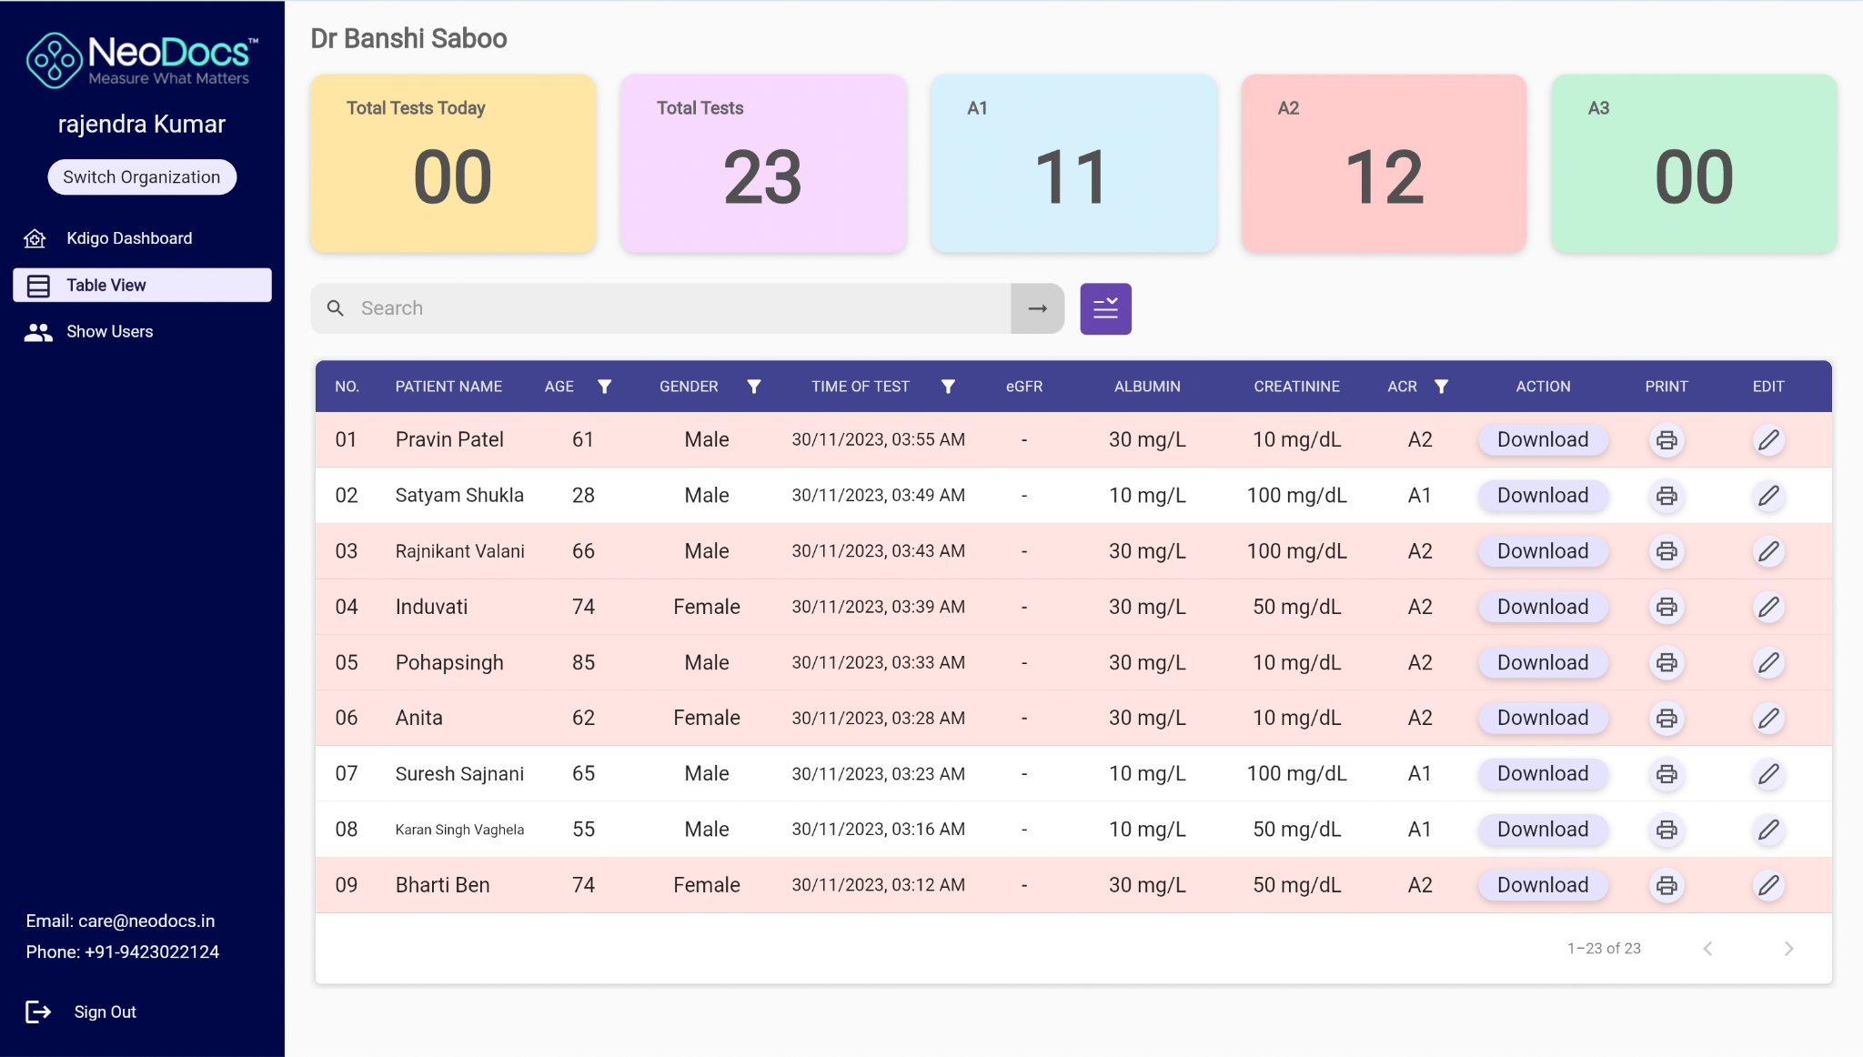
Doctor / Clinic Dashboard
Doctors can login on laptop / desktop for easy access
Can view, print and download report
Clinic level Kdigo Map
Clinic Users (doctor or staff) info
Multi-organization access function
Data filter by age, gender, date, ACR etc.
https://clinic.neodocs.in/

Slide 17
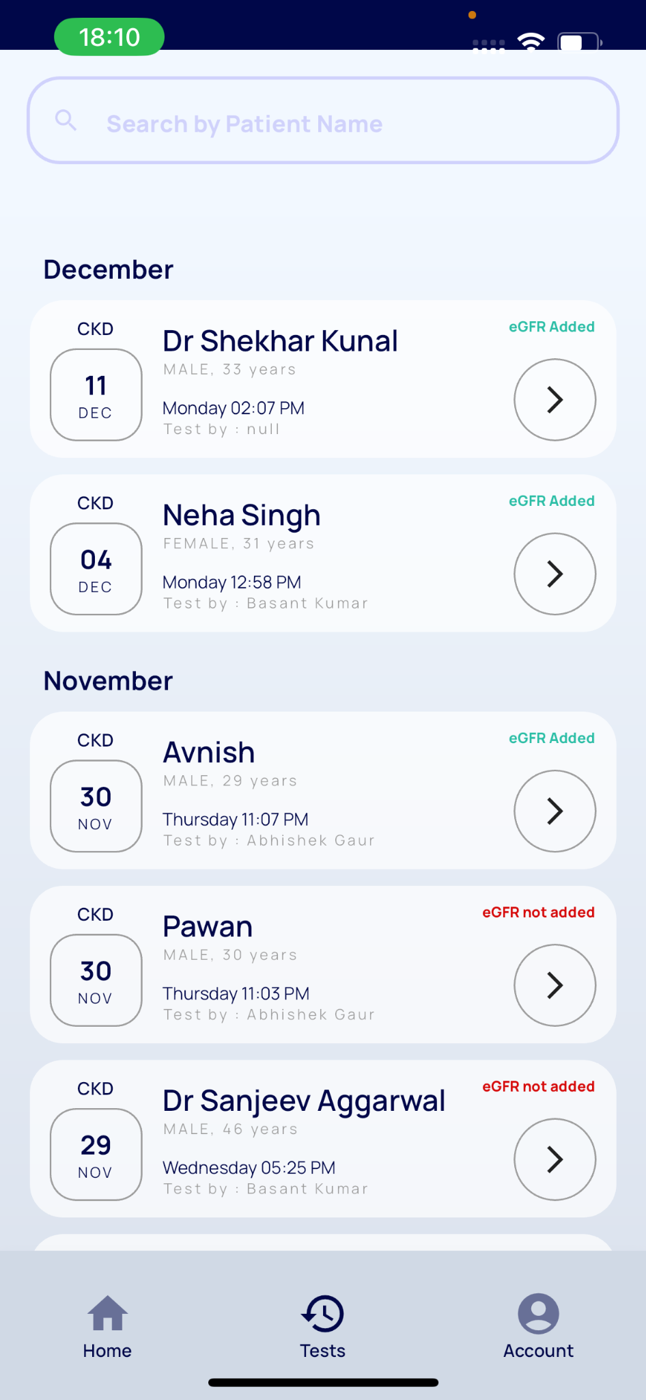
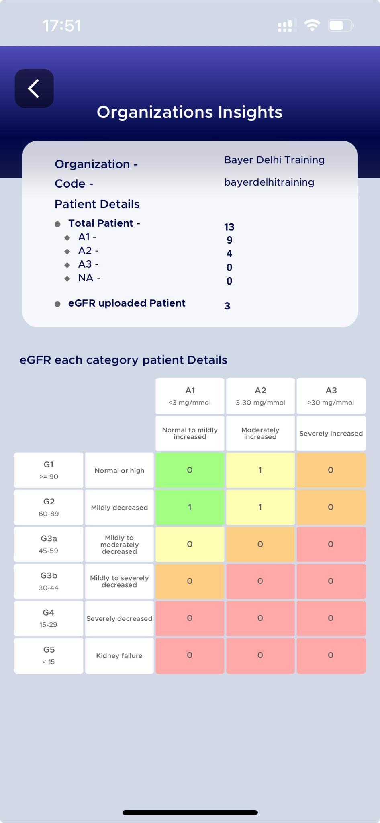
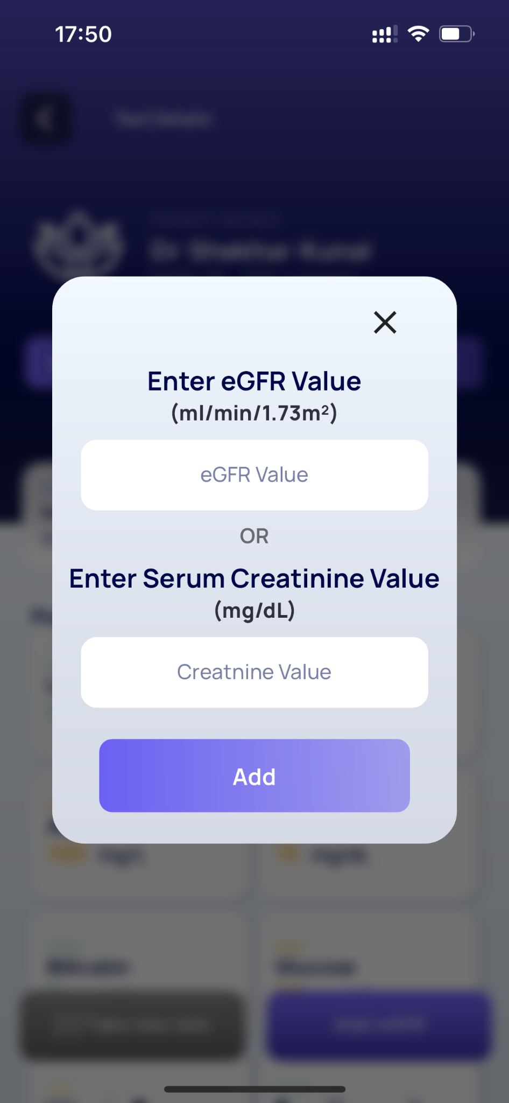
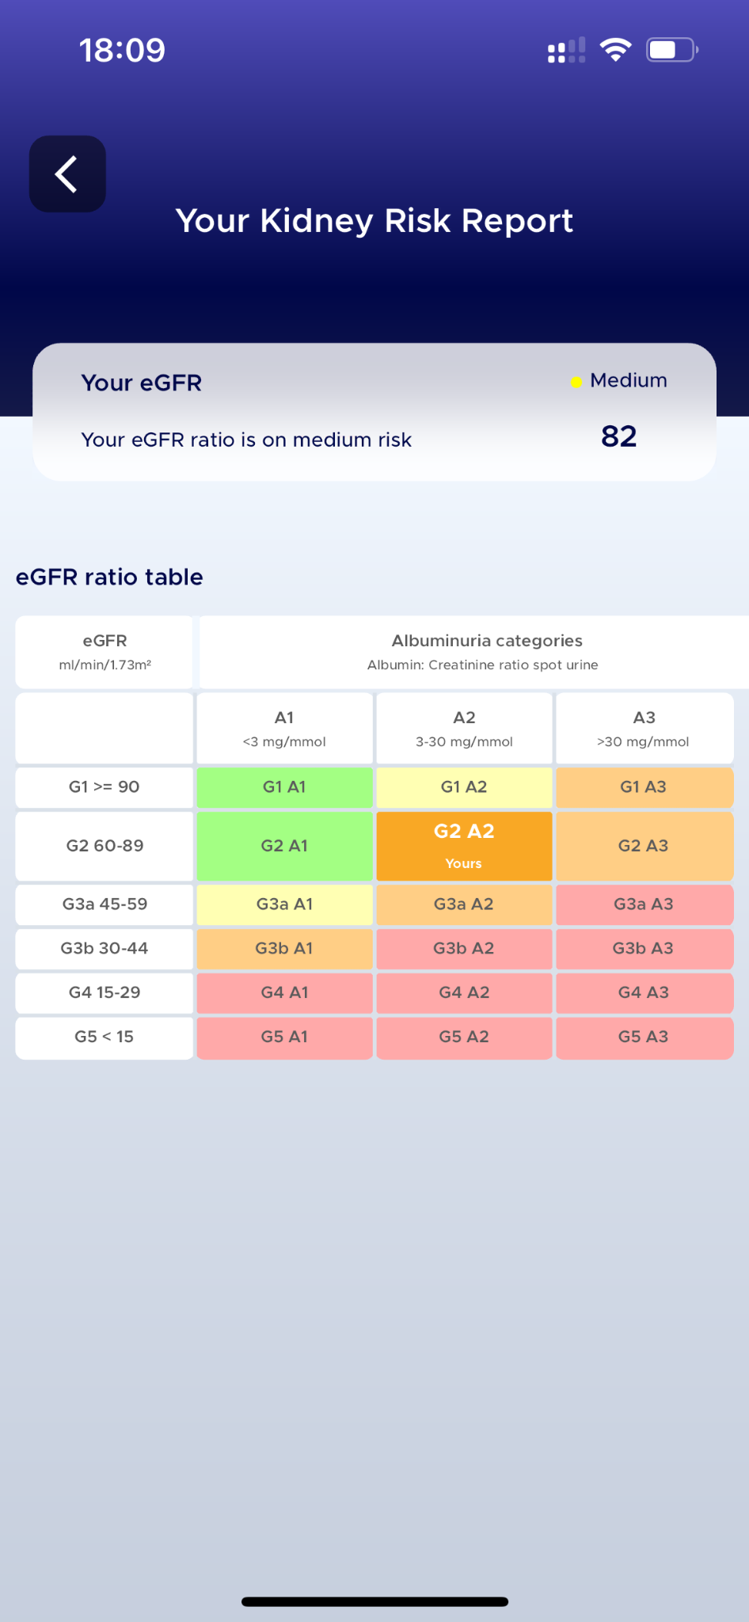
Features: Dr-NeoDocs App Dashboard

Slide 18
Thank you!
Contact Us:
Rajendra Bhaskar +91 99873 39111
Notes:
DON’T FORGET TO SET NEXT STEPS BEFORE LEAVING THE MEETING!

